Slide 2
This document is for informational purposes. It is not a commitment to deliver any material, code, or functionality, and should not be relied upon in making purchasing decisions. The development, release, and timing of any features or functionality described in this document remains at the sole discretion of Oracle. This document in any form, software or printed matter, contains proprietary information that is the exclusive property of Oracle. This document and information contained herein may not be disclosed, copied, reproduced or distributed to anyone outside Oracle without prior written consent of Oracle. This document is not part of your license agreement nor can it be incorporated into any contractual agreement with Oracle or its subsidiaries or affiliates.

Slide 3

Платформа безопасности ORACLE
6-я конференция
«ОБЕСПЕЧЕНИЕ БЕЗОПАСНОСТИ ИНФОРМАЦИИ В КОРПОРАТИВНЫХ ИНФОРМАЦИОННЫХ СИСТЕМАХ. ТЕОРИЯ ВОПРОСОВ, ПРАКТИКА РЕШЕНИЙ»
17-19 октября 2012 г.
Park Hotel & SPA «Солнечный»
Сергей Базылько, к.ф.-м.н.
Менеджер по продажам продуктов информационной безопасности

Slide 4
Корпорация Oracle
Общие показатели
Инвестиции и инновации
36 Млрд. долл. – оборот в 2011г.
№1 в 50 продуктовых / индустриальных категориях
380 000 заказчиков в 145 странах
20 000 партнеров
108 000 сотрудников
14 млн. сообщество разработчиков
32 000 разработчиков и инженеров
18 000 специалистов по техподдержке
17 000 консультантов по внедрению
Поддержка студентов - 1,5 млн. в год
850 пользовательских групп

Slide 5





















Стратегия Oracle
Стэк продуктов
SECURITY
Лучшие продукты
Открытая платформа
Вертикальная интеграция
Экстремальная производительность
Инженерные системы
SECURITY
SECURITY
SECURITY
SECURITY
SECURITY
SECURITY

Slide 6

Oracle как производитель продуктов безопасности
Более 10 лет на рынке
Ведущие решения
Растущие инвестиции
Основа для собственных бизнес-приложений

Slide 7
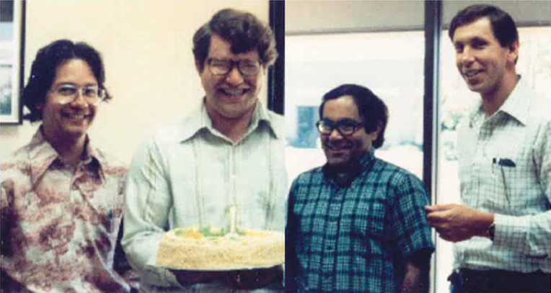
Безопасность в Oracle. 1977. Начало
Первые заказчики – правительственные организации
Первоочередное внимание безопасности

Slide 8
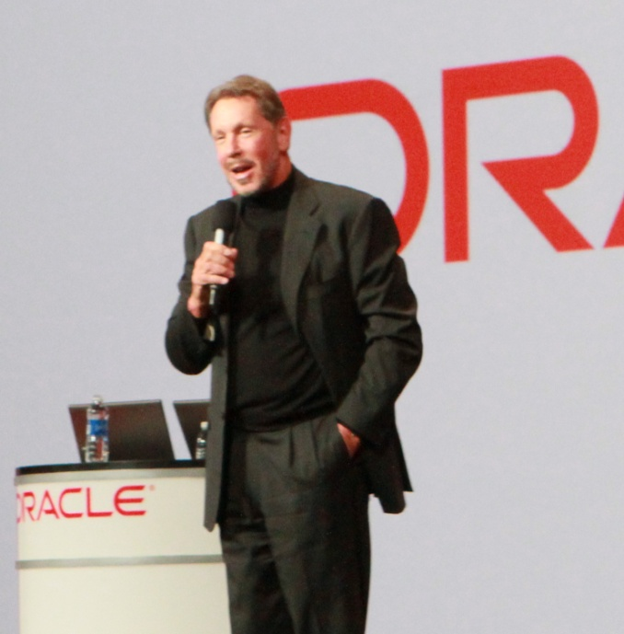
Безопасность в Oracle. Наши дни
Безопасность – следующая платформа масштаба ERP
Платформа безопасности Oracle
Открытость, управляемость, масштабируемость

Slide 9
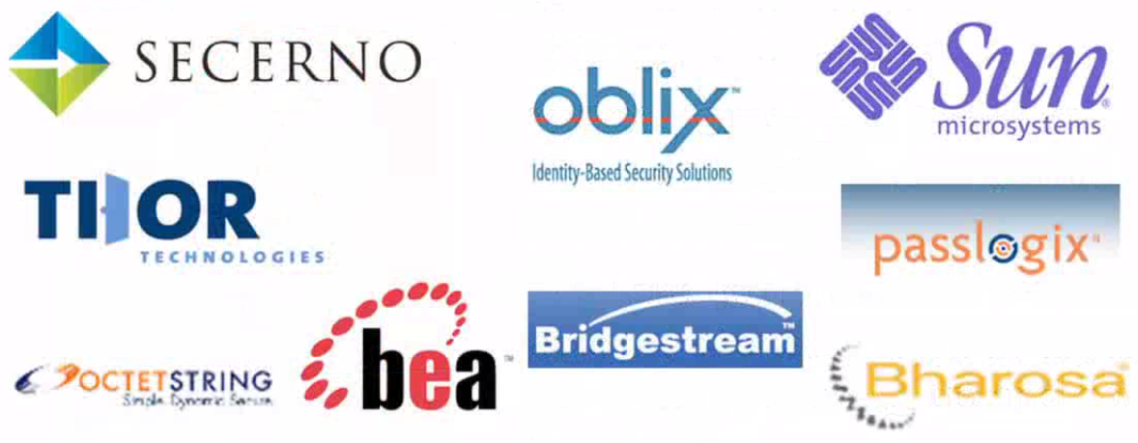
Инвестиции Oracle в безопасность

Slide 10
Почему безопасность?

Slide 11
Безопасность
11
Copyright © 2012, Oracle and/or its affiliates. All rights reserved.
Notes:
If you are a business leader .. You stay up at night worrying about the economy .. You worry about your bottom line .. You worry about your top line.
But for many business leaders security has become a reason to lose sleep
Security risk is a strategic concern for business leaders… the impact of regulatory compliance and the cost of breaches is too large to ignore. We can’t simply purchase an insurance policy against it. The stakes are too high.
( Build)

Slide 12
Фрод
$7Млрд
Société Générale
Кред. карты
Украдены
12Млн
Украденных
Паролей
6Mлн
Sony
LinkedIn
12
Copyright © 2012, Oracle and/or its affiliates. All rights reserved.
Notes:
The criminals are after customer data
At Linked in hackers stole over 6 million user accounts and passwords. This is not an isolated case. Hackers attacking corporations are not only going after their intellectual property, they are also going after their customer data. In the case of linkedin the biggest exposure is to Linkein’s online users. Because users often use the same passwords in multiple places they are now vulnerable. (http://www.nytimes.com/2012/06/11/technology/linkedin-breach-exposes-light-security-even-at-data-companies.html?pagewanted=all
ITS EMBARRASING
IT DAMAGES THE BRAND
The scale of the threat is massive
The Sony breach highlights the volume of the threat. Instead of small breaches our breaches are no larger. The intruders are now bolder. At Sony taking 12M credit cards. These crimes cascade into more crime as fraudulent charges will be made against these credit cards costing the banking industry billions to resolve.
THE CRIMINALS ARE INSIDE
At societe Generale – a trusted star trader who has moved through the ranks .. Aggregated excessive access and avoided auditors until he perpetrated a 7Bn dollar Fraud. The largest case ever.
(All of this in the span of 5 years )
(Build)
The Costs are going up
Bottom line it costs a lot and the average cost is going up.. The problem is we can’t just insure against the risk anymore the stakes are too high
The estimate is that cybercrime costs about 1 Trillion globally
The average breach costs 7.2 Million
ITS NOT A MATTER OF IF IT’S A MATTER OF WHEN

Slide 13

3. Финансовые потери
2. Претензии регуляторов
1. Снижение рейтинга
97%
Можно
предотвратить
13
Copyright © 2012, Oracle and/or its affiliates. All rights reserved.
Notes:
The threat to business is real.
Decline in Brand Value
At Sony the estimate is that the brand 3x its value after the breach. The biggest barrier to wide spread adoption of new services online will depend on security. http://www.securityweek.com/seven-significant-hacks-2011
The cost of rebuilding confidence
After the RSA breach many banks went on a spending spree to replace the tokens that were compromised after the breach. The costs are still being realized. After the RSA breach several customers like Lockheed Martin and General Dynamics were hit.
Societe Generale
The largest internal fraud case in history .. A rouge trader with excessive access created a 7 Billion fraud for the bank
UBS
1 billion fraud – UBS already hurt by the financial crisis was hit by a billion dollar fraud that cause the resignation of the CEO.
97% of it is preventable – if we focus on the risks inside. Verizon data breach report. Because once they get inside that’s where our biggest risks are.

Slide 14


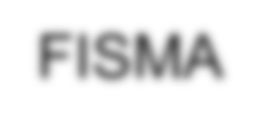



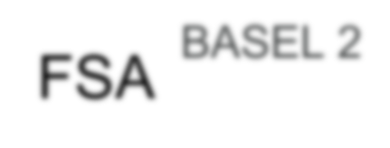


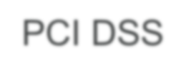




224-ФЗ
115-ФЗ
АСУ ТП
ФСТЭК
СТО БР
40%
Бюджета на безопасность тратится на
Соответствие законодательству
ФЗ 152
ФСБ
SOX
ISO27001
КСИИ
Notes:
Where businesses have failed to manage their risk .. Governments have stepped in to regulate.
Businesses are spending up to 40% of their security budgets on compliance alone.
The spend is only increasing with each state government providing their own privacy laws and privacy regulations
Governance is more challenging
The controls are now more rigorous and intrusive … its not just a single system check its really cross system
* As the perceived risks increase , governments quick to regulate
Many of the new regulations are focused on protecting customer data.
No vertical industry is immune
For more background read ( Forrester the value of corporate secrets online)
http://www.google.com/url?sa=t&rct=j&q=forrester%20the%20value%20of%20corporate%20secrets&source=web&cd=1&ved=0CFAQFjAA&url=http%3A%2F%2Fdownload.microsoft.com%2Fdownload%2FF%2F2%2F3%2FF2398E9C-94FE-496C-BFB2-9DEFE1502ABD%2FForrester%2520TLP%2520-%2520The%2520Value%2520of%2520Corporate%2520Secrets.pdf&ei=PTAPULzIKufniwKF1oHQCQ&usg=AFQjCNHUe5KvsSjWtltN8lsg-erxKE1duw

Slide 15
IT бюджет на ИБ
Информационная безопасность реагирует на требования, упуская из вида защиту самого ценного: данных и приложений
14%
8.2%
1%
2%
3%
4%
5%
6%
7%
0%
0%
1%
2%
3%
4%
5%
6%
7%
8%
9%
10%
11%
12%
13%
2007
2010
Notes:
The velocity of change and the pressure to comply has made businesses reactive. As an example after the RSA breach a survey of security professionals found that approximately 30% of security executives planned to increase security spending as a result of the breach.
The media attention on cyber security and hacking has shifted attention away from the real vulnerabilities. At UBS the trader that caused the billion dollar fraud was not a hacker from a rogue nation. This was an insider who was trusted and who gained excessive access because of the trust the bank placed on him
When criminals break in they go for the low hanging fruit or they come in with stolen credentials. Users with simple passwords and databases that are un-encrypted create more risk than a team of external hackers. Today criminals can purchase passwords and access to our critical systems… these
The cost of remediating a breach exceeds the cost of preventing a breach 10X .. And we need to start taking a proactive approach to it.
~ 7 billion last year on Secure email gateways alone ..
THE NET RESULT IS … WE HAVE INCREASED OUR SECURITY SPEND BUT WE ARE NT ANY SAFER
This stat is from the forrester report evolution in IT security… in 2007 we spent 8.2 percent of IT Budget on Security a significant amount .. In 2010 we spent 14% of IT buget on security on average .. Yet the number of breached records continues to rise. The cost or remediating is higher.

Slide 16
$$$
Защита устройств
Обнаружение уязвимостей
Сетевая безопасность
Защита эл. почты
$400 –$500
94% утечек от атак на сервера
80% утечек через вэб-сервера
32% использование похищенных паролей
Средняя стоимость защиты
на сотрудника
96% данных были в базах данных
5%
привилегиро-ванный доступ
16
Copyright © 2012, Oracle and/or its affiliates. All rights reserved.
Notes:
Cite – 400-500 – Gartner 2010
Cite Breach Stats – Verizon Data Breach 2012
The reactive approach has failed –
Ona per employee basis the average company spends approximately between 400 and 500 dollars on security.
HERE IS WHERE WE ARE SPENDING IT ON WITH IT TECHNOLOGY
End point security . Encrypting laptops … encrypted usb flast drives
Network security
Email security
WHEN WE LOOK AT THE NUMBER OR BREACHED RECORDS THEY ARE AGAINST SYSTEMS THAT WE HAVE NEGLECTED
WE ARE NOT SAYING TO IGNORE PERIMITER SECURITY BUT RATHER SHFIT SOME ATTENTION BACK TO THE STRATEGIC ASSETS.
Even if you could find a way to secure the perimeter and all those end-points, it would be expensive to do it. And costs would keep rising as you add more devices and more applications.
Security already accounts for 14% of annual IT budgets (Forrester)
The real risks are against the apps and data. The risks are against the core systems. While the number of external attacks are rising, the systems most vulnerable are the applications, the data and the infrastructure.
Attacks like simple SQL injection to retrieve data from databases or extracting data sent in clear text across corporate networks.
IDC, "Effective Data Leak Prevention Programs: Start by Protecting Data at the Source — Your Databases", August 2011 http://www.oracle.com/us/products/database/039434.pdf. The fact that that data is doubling every two years is from Gartner.

Slide 17
APPLICATIONS
32%
Взломов использовались украденные учетки
MIDDLEWARE
80%
Украденных записей – с вэб-серверов
DATABASE
96%
Украденных записей были на
серверах баз данных
Центр
OPERATING SYSTEM
5%
Привилегированный доступ
94%
SERVERS
Атак против серверов
3%
Архивные и офлайновые данные
STORAGE
5%
Взломы файловых серверов
17
Copyright © 2012, Oracle and/or its affiliates. All rights reserved.
Notes:
Verizon Data Breach 2012
The breaches are against the core systems.. Our most sensitive data sits on our core systems.
66% of our sensitive data resides in the database ( gartner stat)
The banking fraud at UBS and Societe Generale were causes by excessive access by well truested employees on the inside
The threats start on the outside but are aimed at compromising access to critical systems on the inside.
(BUILD )
When we look at the threats we find that are directly aimed at the stack from Applications to storage

Slide 18
LinkedIn
Системы были уязвимы
Sony
ИЗНУТРИ
Société Générale
Notes:
When We examine some of our biggest cases we find the causes are inside
When we examine Linkedin they found that the passwords for users was only lightly encrypted
When we examine Societe Generale it was not a hacker but a trusted employee with excessive access … it was literally an inside Job.
At Sony …the customer credit card data was not even encrypted… the hackers didn’t have to try very hard it was just lying around.
At RSA – the attack was a phishing attack enabled by an un suspecting end user… while the breach was happening at RSA they could see it happen they did not have the forensics and internal controls in place to stop it.
THESE THREATS ALL STARTED OUTSIDE BUT EXPLOITED INTERNAL RISKS

Slide 19



УПРАВЛЯТЬ РИСКАМИ
SECURITY
INSIDE
OUT
ПРЕДОТВРАЩАТЬ ИНЦИДЕНТЫ
ОТКРЫВАТЬ НОВЫЕ ВОЗМОЖНОСТИ
19
19
Copyright © 2012, Oracle and/or its affiliates. All rights reserved.
Insert Information Protection Policy Classification from Slide 11
Copyright © 2012, Oracle and/or its affiliates. All rights reserved.
Notes:
So we have to start inside … our opportunity is to transform IT security and secure the business inside out. The most successful businesses will take a proactive approach to safeguarding their intellectual property and the information of their customers
[First Build ]
We have to start by being proactive and focusing on the risks. Look at your audits and see where your vulnerabilities are. If your organizations have data that is un-encrypted target that first before you lock down every cell phone. If you have accounts on systems for people who have resigned disable or de-provision these. Make sure you can address the bar on compliance and governance standards.
[Second Build]
Focus on preventing the threats. Look at fraud detection as a PROACTIVE way to prevent breaches before they happen. Protect your data in the applications where they are accessed and created, on the infrastructure & database where it is managed and on the disks where they are archived and stored.
[Third Build]
Unlock the opportunities. The companies that can make security a competitive advantage can unlock the potential of the cloud and harness mobile and social applications to find new paths to market.
Instead of building a wall and hoping it’s strong enough, you need to take control of access in the enterprise – don’t ignore perimeter or endpoint security, but build a security strategy that can prevent, detect and respond to internal as well as external threats.
The endpoints will continue to change and new devices will continuously be introduced. By securing the information when it is created, accessed and stored we can better reduce the risk long term. This kind of inside-out approach to security will help you manage the risk, prevent threats and unlock the opportunities that a secure business can bring.

Slide 20
Облегчить жизнь пользователям
Новые возможности для бизнеса
УГРОЗЫ
СТРАХ
20
Copyright © 2012, Oracle and/or its affiliates. All rights reserved.
Notes:
Today fear drives much of our purchasing and it has not made us any safer. We need to take a more strategic approach
<Build>
Look at security as an enabler to find new paths to business and finding new customers.
Examples,
Web commerce – (More customers)securing customer transactions and preventing fraud enables new opportunities for commerce
Mobile banking – ( More Transactions)enabling mobile applications from devices provides additional transactions and services banks can charge for
Patient Care – (More patients)providing data and medical records to customers over the web increases quality and enables hospitals to serve more patients
Look for opportunities where Security spend can increase share holder value.

Slide 21
control
control
control
Защита данных в течение всего ЖИЗЕННОГО ЦИКЛА
Приблизить средства контроля к ЗАЩИЩАЕМЫМ СИСТЕМАМ
control
Обнаружение фрода
Защита данных
Отчетность о соответствии
control
control
control
control
21
Copyright © 2012, Oracle and/or its affiliates. All rights reserved.
Insert Information Protection Policy Classification from Slide 13
Notes:
The core of the inside out approach is to secure information throughout its lifecycles. Where its created in applications , modified and managed in middleware, and stored on file systems and database server.
As we move our controls closer to the systems and apps they protect our security becomes more efficient … protect the most strategic assets.. And improve visibility.
By moving the controls closer to the applications, infrastructure and database we can better protect our most critical assets
By taking an inside-out approach to securing your most strategic assets, you can unlock the opportunities made possible by a secure enterprise.
But to make all this possible, you need a partner with the necessary expertise and approach to secure your enterprise at all levels. Oracle is the right choice to help you take this step.

Slide 22



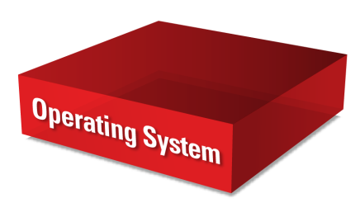
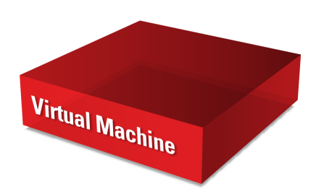
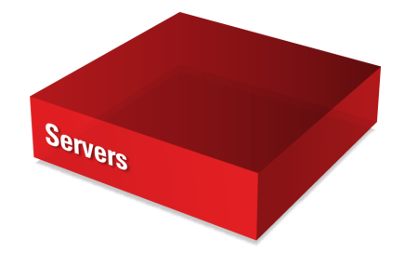
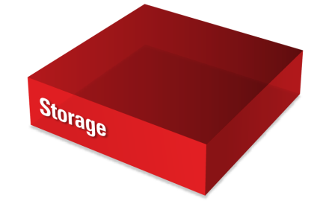
Консалтинг и внедрение
Контроль соответствия
Управление уч. записями
Защита баз данных
Защита инфраструктуры
Notes:
Slide Transition: Oracle provides multiple layers of security to ensure that only authorized users have appropriate access to your systems.
Security at the application layer includes comprehensive compliance management and centralized policy administration to support multiple compliance requirements.
Middleware security provides role-based access controls and identity management, including rights management and identity governance.
At the database layer, data is secured while in motion via SSL 256 bit encryption, and at rest using Oracle’s Transparent Data Encryption. You can transparently encrypt all application data or specific sensitive columns, such as credit cards, social security numbers, or personally identifiable information (PII), without making any changes to existing applications. Data Vault prevents privileged users from accessing application data. Other security measures include tracking configuration and information changes and auditing all database activity.
Finally, security at the infrastructure layer includes hardware level encryption in order to protect data at rest from unauthorized disclosure, alteration and deletion – without impacting performance. Tamper resistant key storage protects cryptographic keys from theft.
This is undoubtedly the most secure software and hardware stack available on the market from a single vendor today.
Lastly we provide services to deploy and manage the stack securely.
Infrastructre Security
Tusted OS Extensions
Virtualization Security
Cryptographic Acceleration
Key Storage Built-In
Secure Storage
Identity Management
Privilege Account Management
User and Role Management
Entitlements Management
Risk-Based Access Control
Directory Services
Risk & compliance
Auditing &Attestation
Segregation of Duties
Process Controls
Transaction Controls
Database Security
Encryption and Masking
Privileged User Controls
Database Firewall

Slide 23
HARDWARE
Безопасность без жертв
SOFTWARE
23
Copyright © 2012, Oracle and/or its affiliates. All rights reserved.
Notes:
Securing your most strategic assets requires deep knowledge of applications and databases.
Oracle is the trusted expert in these fields.
Our understanding of the intersection between hardware and software can help you secure your business without having to worry about any performance trade-offs.

Slide 24
Защита инфраструктуры
Контроль соответствия
БЕЗОПАСНЫЕ ПРОДУКТЫ&
ПРОДУКТЫ для БЕЗОПАСНОСТИ
Управление уч. данными
Защита баз данных
Консалтинг и внедрение
Notes:
Security like quality is a function of how we engineer and test our products. We have teams dedicated to penetration test of our systems and testing for secure coding standards.
We ship security products to help customers secure their Oracle technology and non-Oracle technology

Slide 25
Многоуровневая защита
SECURITY
Безопасность
самого ценного
INSIDE
OUT
25
Copyright © 2012, Oracle and/or its affiliates. All rights reserved.
Notes:
Security isn’t a “nice to have” – it’s a vital issue that’s affecting businesses worldwide.
In order to address it cost effectively, you need to think strategically about your approach – and that means focusing on the most valuable assets and the biggest threats.
Oracle’s inside-out strategy can help you prevent internal risks and protect your applications and databases - while also reducing costs and improving the user experience.
We can’t afford to secure everything .. Today there are 5.9 billion mobile phones tomorrow 5 billion smart cars.

Slide 26
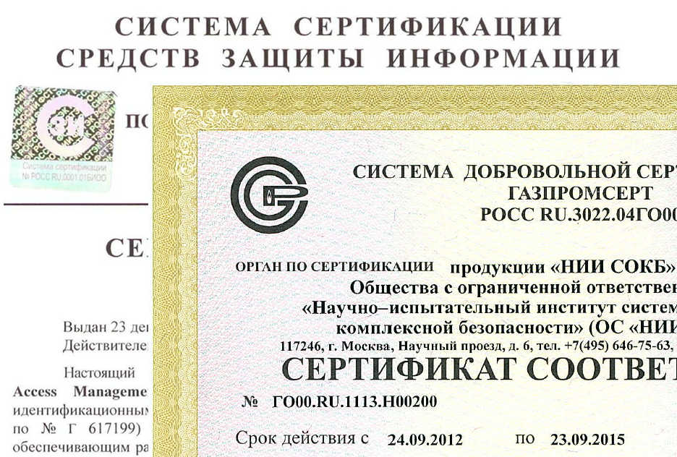
Oracle в России
Сертификация
Локализация
Партнерская сеть
Совместные решения

Slide 27
Партнерские решения
Аладдин-РД: КриптоБД
КриптоПро: ЭЦП для Java (IDM, OeBS, WCC)
Infowatch: DLP
Digt & КриптоПро CSP: Аутентификация по ГОСТ
1С: коннектор для Oracle Identity Manager
Инновационные технологии: решение по защите печатных копий

Slide 28






УПРАВЛЯТЬ
РИСКАМИ
Notes:
We need to refocus our attention… while the THREATS ARE OUTSIDE THE RISKS ARE INSIDE…
THE RISKS ARE AGAINST OUR CORE SYSTEMS
We have to stop being reactive and re-focus our attention on our core systems… improve the cost effectiveness of our security.

Slide 29
ПРЕДОТВРАЩАТЬ
ИНЦИДЕНТЫ
Notes:
We have to be preventive… invest before a breach .. The COST OF REMEDIATING THE BREACH IS 10x the cost of prevention

Slide 30
ОТКРЫВАТЬ
НОВЫЕ ВОЗМОЖНОСТИ
Notes:
Align security with your business … use security as a way to increase shareholder value.
If you have a plan to grow your on-line business – talk to us
If you have a plan to engage new customers on mobile apps and social media – talk to us
Look at security as a competitive advantage… security is a business innovation.

Slide 31


Slide 32
ОБЕСПЕЧИТЬ
БЕЗОПАСНОЕ БУДУЩЕЕ
Notes:
Oracle is the right partner because WE HAVE A SECURITY INSIDE OUT APPROACH .. AND WE SECURE THE SYSTEMS AT THE CORE.
Now you can get some rest.. or stay up thinking about other problems

Slide 34
Защита печатных копий

Slide 35
Защита печатных документов
Преимущества печатных документов
  Энергонезависимы
  Легкие
  Можно делать надписи
Риски печатных документов
  Отсутствует контроль за распространением

Slide 36


Судьба печатной копии документа

Slide 37

Судьба печатной копии документа
Internet
Notes:
Печальная судьба печатной копии документа

Slide 38
Как определить нарушителя?
?
?
Internet

Slide 39
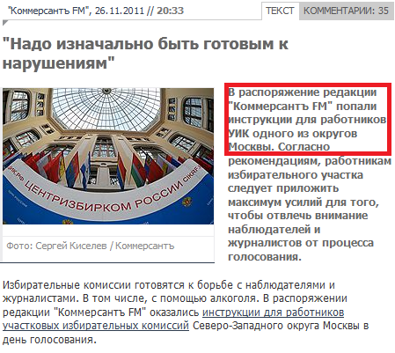
В распоряжении редакции оказался документ..

Slide 40
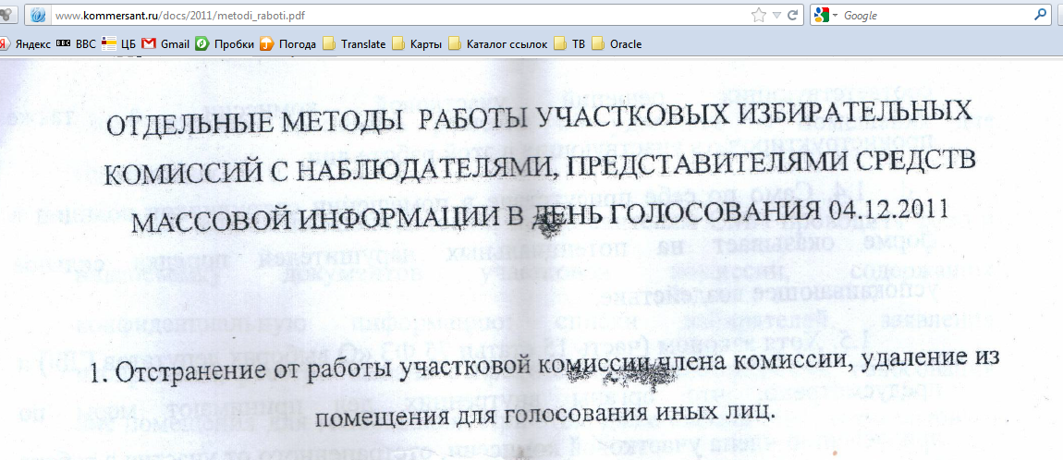
В распоряжении редакции оказался документ..

Slide 41
Требования ФСТЭК
Руководящий документ. Автоматизированные системы. Защита от несанкционированного доступа к информации. Классификация автоматизированных систем и требования по защите информации
  Класс 1Г-1А:
    должна осуществляться регистрация выдачи печатных (графических) документов на "твердую" копию. Выдача должна сопровождаться автоматической маркировкой каждого листа (страницы) документа его последовательным номером и учетными реквизитами АС с указанием на последнем листе документа общего количества листов (страниц). В параметрах регистрации указываются:
        дата и время выдачи (обращение к подсистеме вывода);
        спецификация устройства выдачи [логическое имя (номер) внешнего устройства];
        краткое содержание (наименование, вид, шифр, код) и уровень конфиденциальности документа;
        идентификатор субъекта доступа, запросившего документ;
        объем фактически выданного документа (количество страниц, листов, копий) и результат выдачи: успешный (весь объем), неуспешный;
Маркировку можно скрыть при копировании
Notes:
Примеры реализации: АМДЗ Аккорд от ОКБ САПР, Secret Net 6 от Код Безопасности, Oracle WebCeneter

Slide 42
Требования Газпром
СТО Газпром 4.2-2-003-2010. Система обеспечения информационной безопасности ОАО «Газпром». Требования по защите от подделок документов на бумажных носителях.
  6.3 Дополнительные защитные признаки оригинала документа
    6.3.1 Дополнительные защитные признаки могут быть установлены (внесены, нанесены, встроены) в документ или объект защиты как до, так и после его окончательного формирования.
    6.3.2 Технология установления защитных признаков должна позволять проводить однозначную идентификацию оригинала документа, не должна ухудшать качество защищаемого документа и препятствовать его использованию по назначению.
    6.3.3 Маркировка защищённых документов надписями, свидетельствующими об установлении защитных признаков, например «Защищено от копирования», не допускается.

Slide 43
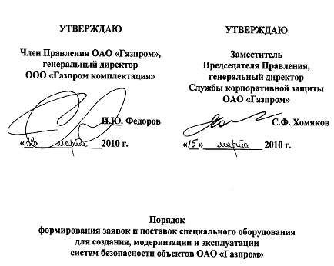
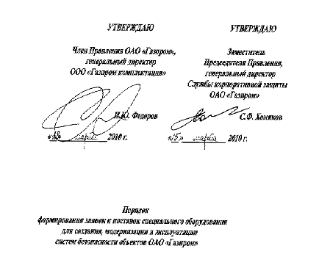
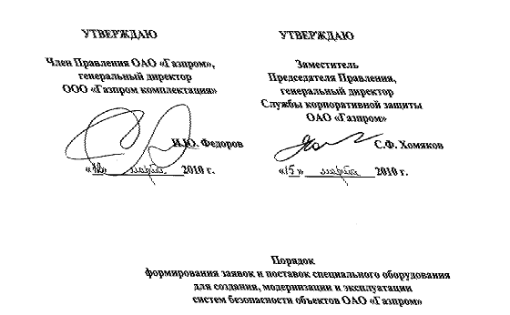
SafeCopy
Оригинальный документ
Уникальная копия для каждого пользователя
Учет и хранение параметров преобразования для каждого пользователя (Oracle WebCenter Content)
Газпром комплектация (Иванов)
НИИ СОКБ (Петров)

Slide 44
SafeCopy
Оригинальный документ
Уникальная копия для каждого пользователя
Учет и хранение параметров преобразования для каждого пользователя (Oracle WebCenter Content)
Газпром комплектация (Иванов)
НИИ СОКБ (Петров)

Slide 45
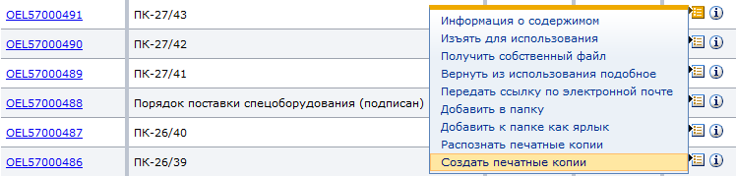
SafeCopy
Создание защищенных копий

Slide 46
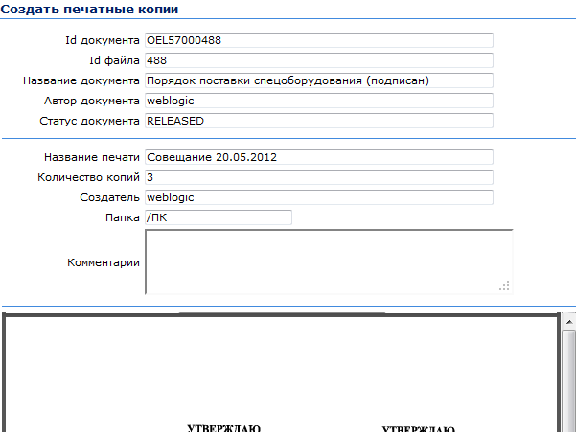
Создание копий
Оператор задает количество защищенных копий

Slide 47
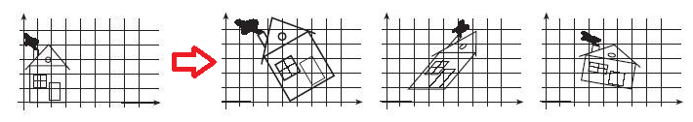
Параметры защищенных копий
Аффинное преобразование:
Растяжение (сжатие), сдвиг, перенос

Slide 48

Параметры текста
Расстояние между буквами, строками, словами

Slide 49
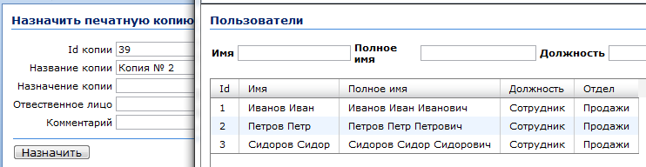
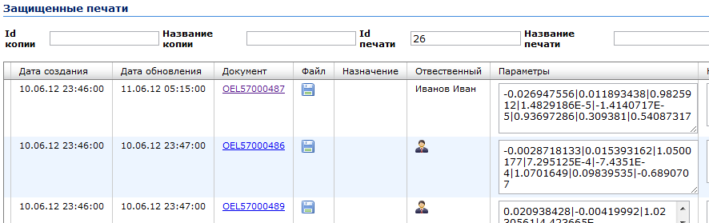
SafeCopy
Создание, хранение и обработка защищенных копий
Автоматическое задание параметров защищенных копий
Защищенное хранение документов и копий (Oracle)
Централизованный учет выданных копий

Slide 50
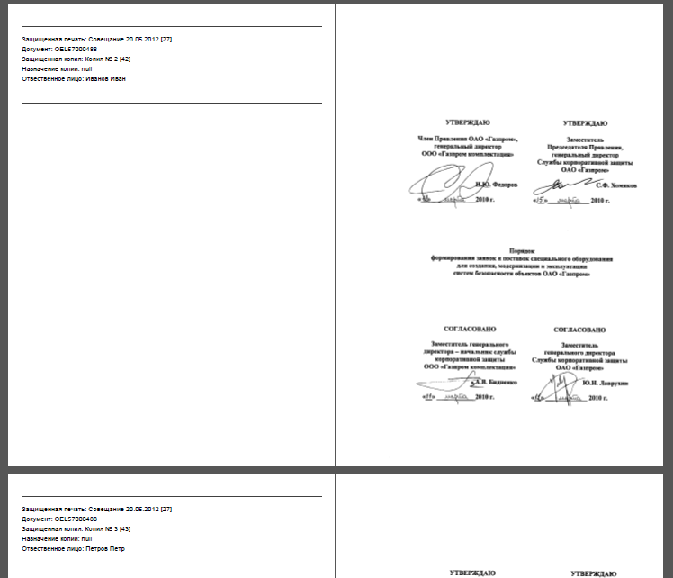
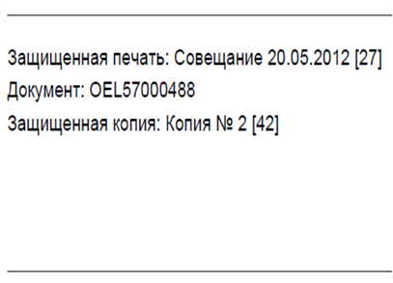
SafeCopy
Подготовленные защищенные копии

Slide 51
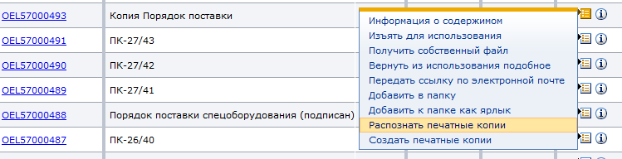
Порядок действий при обнаружении утечки
Задание на распознавание

Slide 52
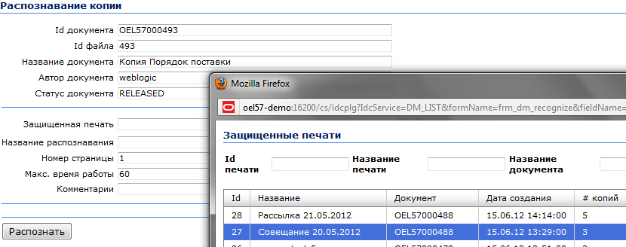

Задание на распознавание
Выбор документа

Slide 53
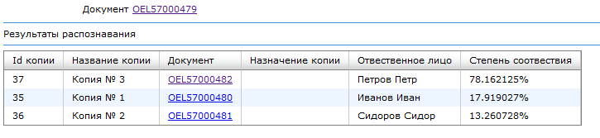
SafeCopy
Результат распознавания

Slide 54

Определение степени соответствия
Степень соответствия =
количество красных точек
/
количество черных и красных
* 100%
Процент перекрытия букв
Степень соответствия =
количество красных точек
/
количество черных и красных
* 100%

Slide 55
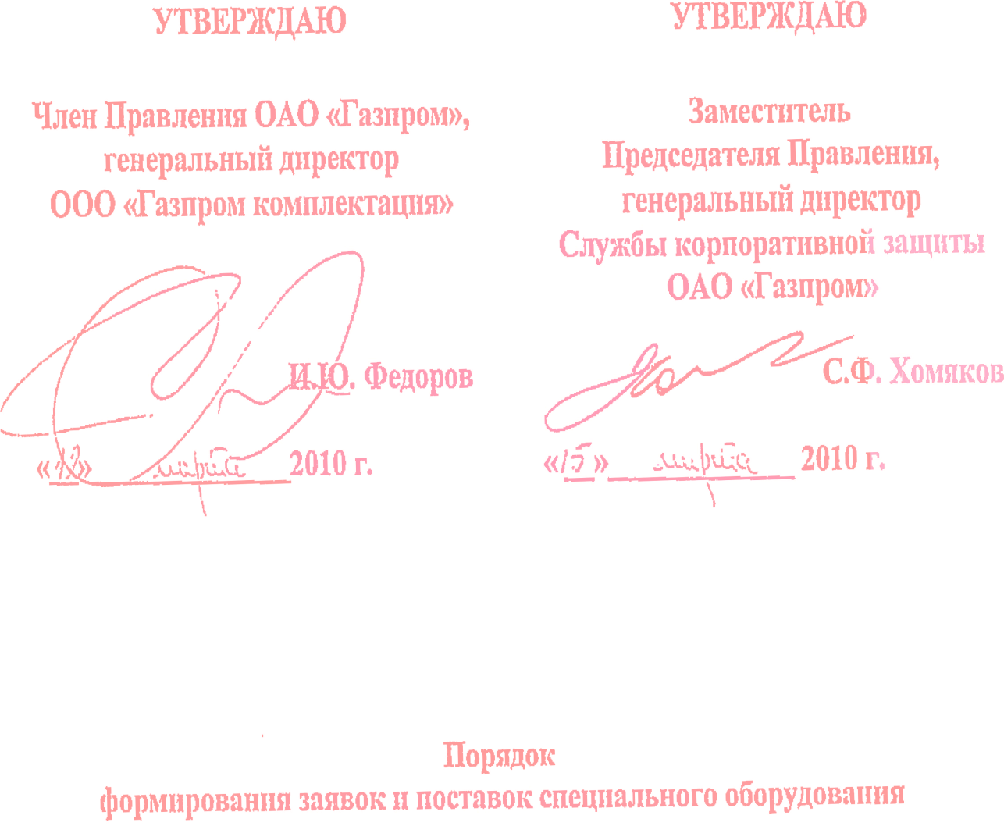
Соответствие 100%
Все точки красные

Slide 56
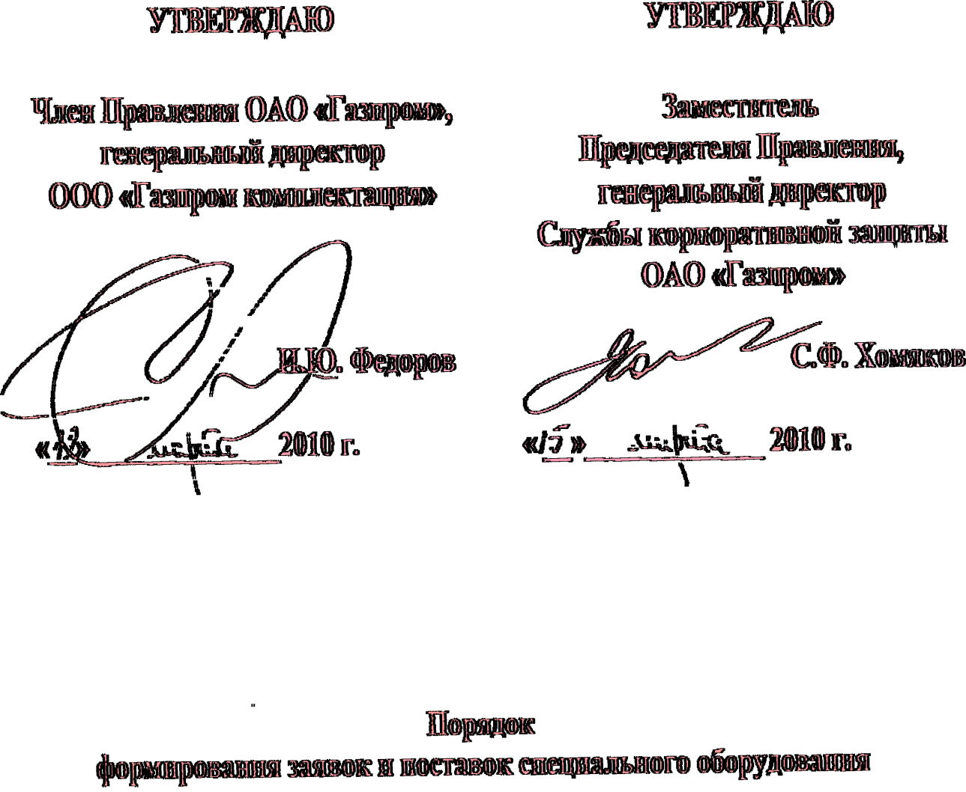
Соответствие 78%
Расположение букв совпадает

Slide 57
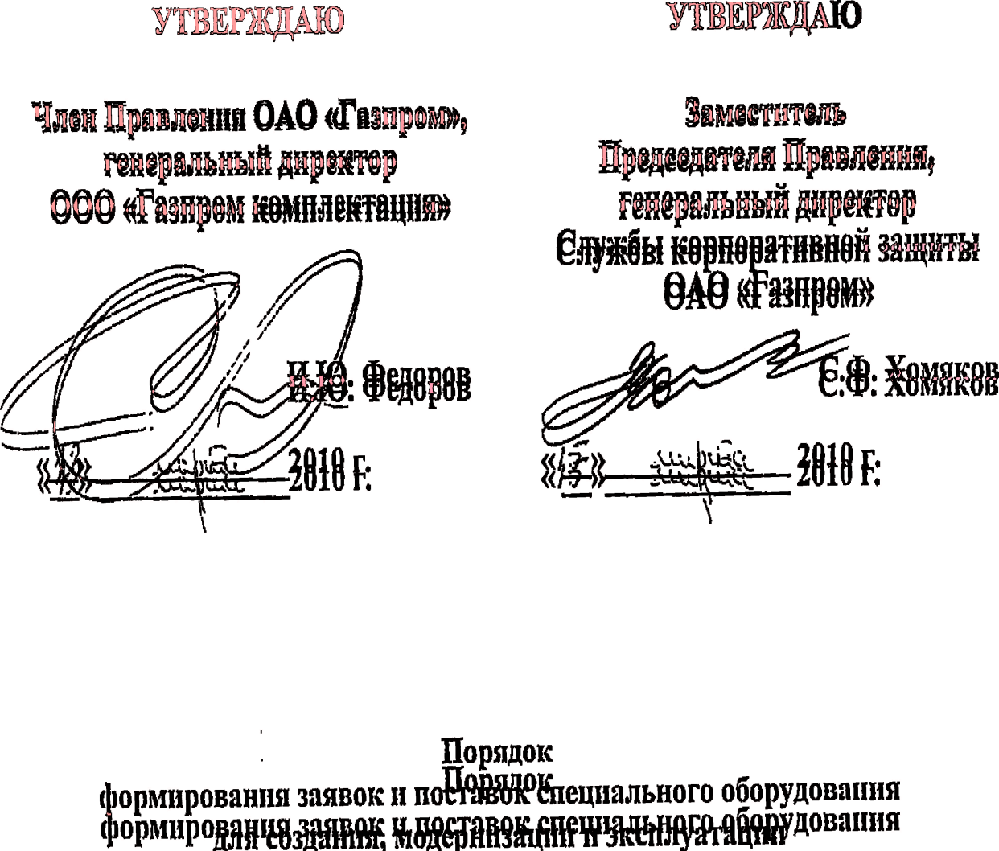
Соответствие 13%
Расположение букв совпадает в начальной части документа

